Slide 1
MGM Institute of Physiotherapy
ELECTROMYOGRAPHY
Dr. Preeti Ganachari
Dept. Of Neurophysiotherapy
Mgm Institute Of Physiotherapy
Chh. Sambhajinagar

Slide 2
Contents
History of EMG
Introduction
Instrumentation
Procedure and guidelines
Contraindications
Normal and abnormal activities
Evidences
References

Slide 3
History
The earlier historical evolution of EMG was coupled to the modern discovery of electricity in the mid-18th century.
Significant progress had to wait until the early 20th century when equipment capable of amplifying and recording the fine bioelectric potentials were invented.
Neurologists began to contribute not only by describing the electro physiologic findings, but also by attaching clinical and sometimes pathologic significance to them.
Of note, Edgar Adrian was most probably the first formally trained neurologist to be involved.

Slide 5
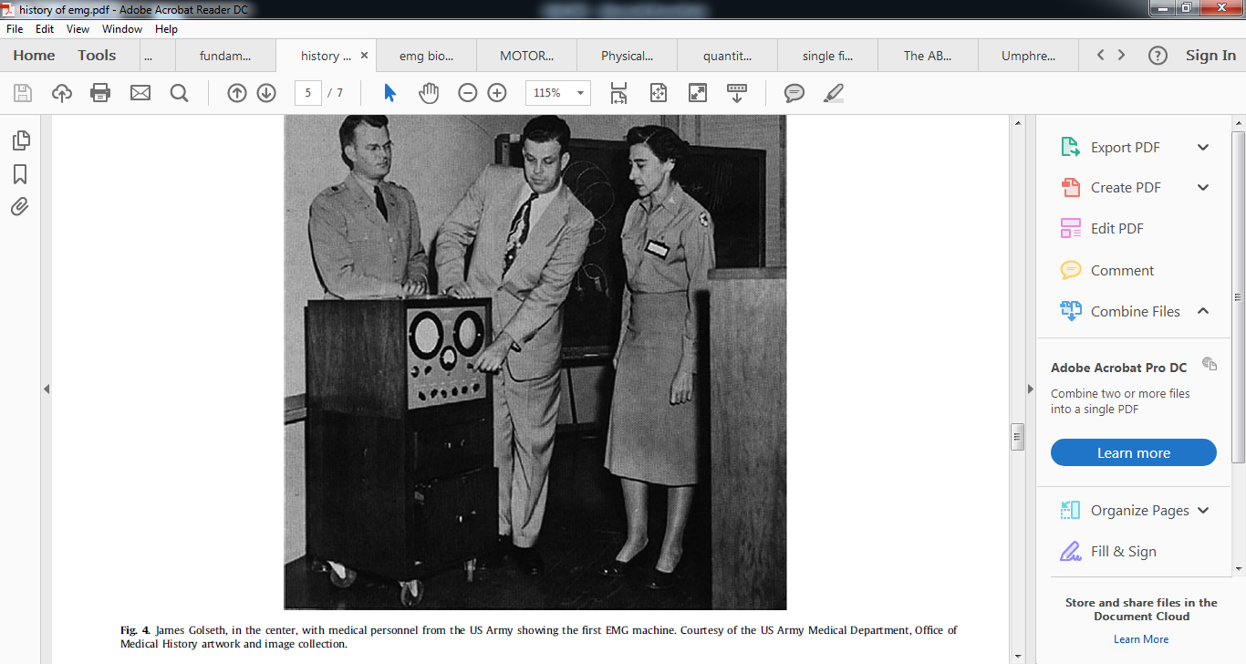

Slide 6
Definition
"Electromyography (EMG) is an experimental technique concerned with the development, recording and analysis of myoelectric signals. Myoelectric signals are formed by physiological variations in the state of muscle fiber membranes.“
EMG is the recording of the electrical activity of muscle based on motor unit activity.
Activity of contracting muscle provides information concerning the structure and function of the motor units.

Slide 7
Motor unit
MOTOR UNIT:
Composed of one AHC,
one axon, its
neuromuscular junction
and all muscle fibers
innervated by that axon

Slide 8
Types of EMG
Diagnostic Or Clinical Electromyography
Kinesiological Electromyography
Emg Biofeedback
Single Fibre Emg
Macro Emg
Qualitative Vs Quantitative

Slide 9
Diagnostic or clinical electromyography:
It is used for the study of diseases of muscles, neuromuscular junctions and nerves(electrodiagnosis).
The electric potentials from the skeletal muscle fibers are recorded and analysed for the study of some disease processes.
EMG and Action Potentials.mp4

Slide 10
Healthy muscle fibers contract only when they are activated by neurons and hence under normal conditions, only the motor unit action potentials are seen.
In neuromuscular disease, single muscle fiber may contract apparently spontaneously and this may be recognized by the action potential derived from small group of fibers.

Slide 11
Clinical electromyography
It provides useful data regarding nerve injury. Such as,
- Site of injury
-Type of injury
- Severity of lesion
-Duration
-Prognosis

Slide 12
Kinesiological electromyography
It is used in the study of muscle activity and to establish the role of various muscles in specific activities.
Kinesiological EMG is beneficial for producing the objective means for documenting the effects of treatment on muscle impairments.
It is used to examine the muscle function during the specific, purposeful tasks or therapeutic regimen.

Slide 13
Uses of kinesiological EMG

Slide 14
EMG Biofeedback

Slide 15
Quantitative electromyography by Gulapar Phongsamart have reviced the concept of EMG.
The motor unit and quantitative electromyography by Mark B. Bromberg in 2019 concluded that QEMG in its basic form captures E-MUPs leading to unbiased listing of discrete values for basic and derived metrics in understanding of neuromuscular physiology or pathology.

Slide 16
EMG biofeedback for the recovery of motor function after stroke (Review) conducted in 2009 by Woodford HJ, Price CIM concluded that EMG-BFB plus standard physiotherapy produces improvements in motor power, functional recovery and gait quality
Woodford HJ, Price CI. EMG biofeedback for the recovery of motor function after stroke. Cochrane Stroke Group, editor. Cochrane Database of Systematic Reviews [Internet]. 2007 Apr 18 [cited 2020 Jul 11];

Slide 17
The Components of Electromyography
1. Electrodes
2. Amplifier system
3. Display system.
The Electrodes:
They are used in the input phase for picking up of electrical potentials from the contracting muscle fibres. The electrodes are of following types:
a. Surface electrodes b. Needle electrodes
c. Fine wire indwelling electrodes d. Single fibre needle electrodes
e. Macroelectrode f. Intra cellular electrode
g. Multi lead electrode

Slide 18
Surface electrodes:
Surface electrodes are basically used for kinesiological investigations.
These are made up of small disc of electrodes most commonly of silver or silver-chloride.
The diameter of electrode is generally 3 to 5 mm.

Slide 20
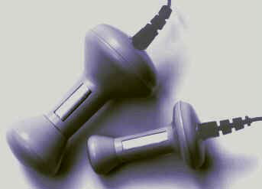
Non invasive, easy handling (SENIAM)
But only for surface muscles
Generally wet-gel electrodes have better conduction and lower impedance than adhesive gel electrodes.
Vaginal or anal probes-
for pelvic floor examination.
Notes:
Surface electrode
They are not considered selective enough to record activity accurately from an individual motor unit or from specific small or deep muscles unless special recording procedures with adequate amplifiers and filtering procedures are used.

Slide 21
Needle electrodes:
They are used for clinical electromyography for recording single motor unit potential from different parts of a muscle.
The different types of needle electrodes used are:
Concentric (coaxial) needle electrode
Monopolar needle electrode
Bipolar needle electrode
Risk
Pain
Bleeding
Infection
Pneumothorax
Needle stick injury

Slide 22
Handbook of Clinical Neurology, Vol. 160 (3rd series) Clinical Neurophysiology: Basis and Technical Aspects by K.H. Levin and P. Chauvel shares the basic concept of needle electromyography.

Slide 23
Concentric (coaxial) needle electrode:
This type of electrode consists of a stainless steel cannula through which a single wire of platinum or silver comes out.
The cannula shaft and wire are insulated from each other and only their tips are exposed. They act as electrodes and potential difference between
them is thus recorded.

Slide 24
Monopolar needle electrode:
These are composed of single fine needle which is insulated except at its tip. A second surface electrode is placed on the skin near the site of insertion which serves as a reference electrode. These electrodes are less painful than concentric electrodes because they are much smaller in diameter

Slide 25
Bipolar needle electrode:
These consist of a cannula containing two insulated
wires with their bare tips. The bared tips of both wires act as the two electrodes
and the needle serves as the ground

Slide 26
Fine wire indwelling electrodes:
These are used for kinesiological study of small and deep muscle.
It is made by using two fine wires of small diameter with polyurethane coating or nylon insulation.
Insulation is removed from the tip of the wires and hooks are created to keep the wires imbedded while the needle is removed from the muscle

Slide 27
Single fibre needle electrodes:
These are concentric wires of 25 μm diameter and contain stainless steel cannula of 0.5 mm diameter.
This gives information about propagation velocity along the muscle fibres.
Single fibre needle records from a small area and hence it cannot be used for motor estimation of motor unit size.
Single fibre EMG is employed to study neuromuscular transmission abnormality and fibre density.

Slide 28
A study named Guidelines for single fiber EMG by Donald B. Sanders and his co workers in 2019 had given guidelines for the purpose and use of single fibre EMG.

Slide 29
Macroelectrode:
Macroelectrode is a concentric needle electrode of 15 mm shaft.
It records from a large number of motor units along the shaft of the needle.
The recording from one motor unit is separated by using a single fibre needle attached to macro electrode in the midshaft.
This method gives information concerning the whole motor unit but has not at present widely applied to the study of pathological motor units.

Slide 30
This method gives information concerning the whole motor unit but has not at present widely applied to the study of pathological motor units.

Slide 31
Intra cellular electrode:
This is an extremely fine electrode of diameter 0.5 μm and is used to record the potential changes inside the membrane across a cell.
It is made so fine so as to penetrate deep inside a cell or intracellular matrix.
Multi lead electrode:
This electrode consists of a common steel cannula which comprises of at least three insulated electrodes at regular intervals inside it.

Slide 32
Erik Stalberg study the use of single fiber EMG and macro EMG in study of reinnervation
SFEMG gives information about changes in the topography of the motor unit and in function of transmission in terminal nerve, motor endplate and muscle fiber. Dynamics of reinnervation may be studied with this technique. The amount of reinnervation is obtained from macro EMG studies.
Year- 1990

Slide 33
Karin Roeleveld study about motor unit size estimation for confrontation of surface EMG with macro EMG
Fifty-eight channel SEMG was recorded simultaneously with Macro EMG.
All recordings were made from the biceps brachii of healthy subjects during voluntary contraction at low force. High positive correlations were found between all Macro and Surface motor unit potential (MUP) parameters. The MUPs recorded with SEMG were dependent on the distance between the MU and the skin surface..
MUPs recorded with this type of SEMG provide useful information about the MU size.

Slide 34
STEP BY STEP
Select the muscle
Locate insertion point by asking the pts to contract and relax
Insert needle
stable electrode contact
low skin impedance
Muscle activity recorded
Display on screen
Analysis

Slide 35
It is done in four steps-
-Insertional Activity -Spontaneous Activity
-Motor Unit Potential -Interference Pattern

Slide 36
1] Injury potential/ insertional activity –
This activity is also called injury potential, because it represents discharge from injured muscle fibers ,muscle normally is quiet at rest, except for the potentials seen at end plate zones.
When the needle is quickly moved through muscle, there is brief burst of muscle fiber potentials typically no longer than 300ms after then needle has stopped moving i.e. insertional activity.

Slide 37
EMG Normal Insertional Activity.mp4
absent insertional activity.mp4
increased insertional activity.mp4

Slide 38
Increased insertional activity is defined as any activity other than end plate potentials that lasts longer than 300ms after brief needle movement it may seen in neuropathic or myopathic lesion.
Where muscle has been replaced by fat and fibrous connective tissue insertional activity may actually be reduced.
The presence of insertional activity is important to the electromyographer to confirm that needle is in muscle rather than fat or subcutaneous tissue.

Slide 40
2]Spontaneous activity
Muscle is normally electrically silent outside of the end plate zone.
Any persistent spontaneous activity out of the end plate zone, usually defined as lasting longer than 3 sec is abnormal.
Spontaneous activity may be ongoing when the needle is placed in the muscle or may be triggered by needle movement, voluntary muscle contraction, muscle percussion or electrical stimulation.Normal EMG biceps.mp4
All spontaneous activity is abnormal , exception of potentials that occur in the muscle endplate zone(i.e. NMJ)

Slide 41
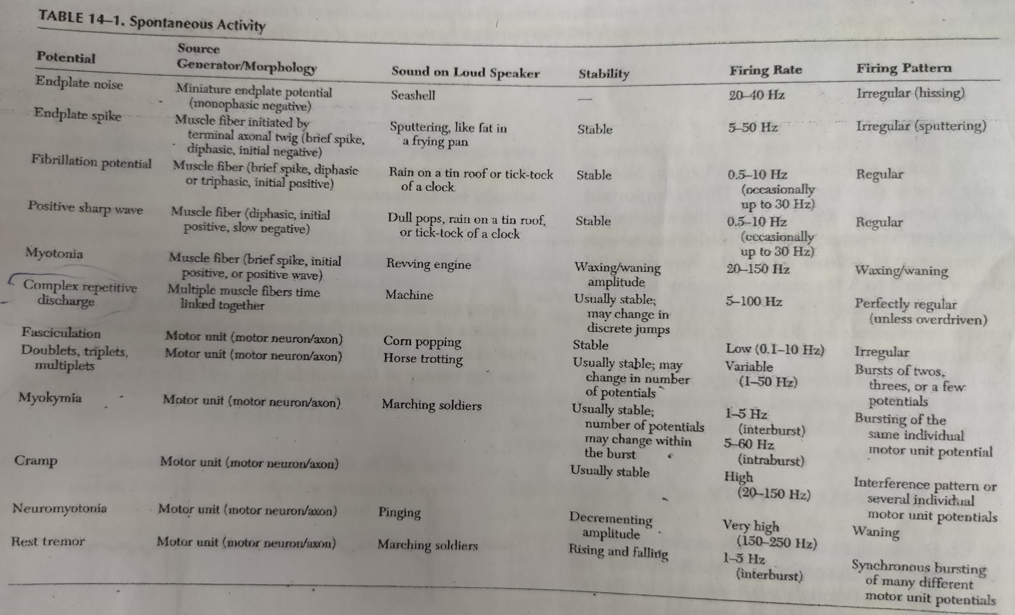
Two types of spontaneous activity occur at end plate zone
End plate noise Endplate spike

Slide 43
3] Motor unit potential or potential at minimal activity-
Muscle potentials evoked by isolated discharges of motor neurons recorded with mild voluntary contraction of muscle. This is motor unit potential or potential at minimal activity.
4] Potential at maximal activity-
Changes in electrical potential is assessed as the muscle contraction gradually increases and reaches a maximum at maximal effect ( recruitment and interference pattern)

Slide 44
Guidelines
• Wet gel electrodes have the best skin impedance values
• Use small electrodes to increase the selectivity of your measures (avoid cross-talk)
• The smaller the electrode (active detection area) the higher the impedance values
• Select the closest possible inter-electrode distance to increase selectivity
• The general recommendation for the inter-electrode distance is 2 cm (center point to center point)

Slide 45
Guidelines
• Apply electrodes in parallel to the muscle fiber direction
• Use the most dominant middle portion of the muscle belly for best selectivity
• Avoid the region of motor points if possible (see next page)
• Take care that the electrode site remains on the active muscle mass during muscle shortening
• Use a map system with measured distances between the electrode site and dominant anatomical landmarks
• Use electrodes with de-centralized snap/cable connection if you expect increased pressure on electrodes (e.g. sitting on electrodes)

Slide 49
The myoelectric signal:
The EMG electrodes convert bioelectric signal resulting from muscle or nerve depolarization into an electrical potential capable of being processed by an amplifier.
The difference of electric potential between the two recording electrodes is processed.
The potential difference is measured in volts.
The amplitude or height of potential is measured in microvolts.
The potential difference and the amplitude are directly proportional to each other, the greater the potential difference between the electrodes the greater the amplitude.
The amplitude of motor unit potential is measured from the highest to the lowest point

Slide 50
Amplifier system
Before the motor unit potential can be visualized, it is necessary to amplify the small myoelectric signals. An amplifier converts the electric signal large enough to be displayed.
Differential amplifier:
The electric potential is composed of the EMG signal from the muscle contraction and unwanted noise from the static electricity in the air and power lines.
To control for the unwanted part of the signal, the differential amplifier is used, as noise is transmitted to the amplifier as a common mode signal when the difference of potential is reduced at both the ends, the noise being cancelled out both the ends of amplifier.

Slide 51
Amplifier- processor phase

Slide 52
Common mode rejection ratio:
Actually, noise is not eliminated completely in the differential amplifier.
Some of the recorded voltage includes noise.
The common mode rejection ratio (CMRR) is a measure of how much the desired signal voltage is amplified relative to the unwanted signal.

Slide 53
Signal to noise ratio:
Noise can be generated internally by the components of the amplifier system such as resistors, transistors, or the circuit.
This noise can be observed by the hissing sound on an oscilloscope.
The factor that reflects the ability of the amplifier to limit this noise relative to the amplified signal is the signal to noise ratio.
This ratio can also be described as the wanted signal to the unwanted signal.

Slide 54
Gain:
The gain refers to the ratio of the output level of signal to the input level of signal.
This characteristic refers to the amplifier’s ability to amplify the signals.
A higher gain will make a smaller signal to appear larger on the display system.
Input impedance:
Impedance is a resistive property present in the alternating current circuits.
Impedance is present at the input of the amplifier and as well as at the output of the electrodes and they are directly related to the voltage.
As per law, if the impedance at the amplifier is more than the impedance at the electrodes, the voltage will drop more and more accurately it represents the signal.

Slide 55
On contrary, if the impedance at the electrodes is more than the impedance at the amplifier, the voltage drop will be less.
Also, the impedance depends on many factors such as skin resistance, material of the electrodes, size of the electrodes, length of the leads and electrolyte, etc. Blood, skin and adipose tissue also offer resistance to the electrical field.
Frequency band width:
The EMG waveforms as processed by an amplifier are actually the summation of signals of varying frequencies.
The frequency is measured in Hertz.
The frequency of an EMG signal is inversely proportional to the inter electrode separation.

Slide 56
Display system
The amplified or processed signal is displayed in a useful manner.
The form of output used depends upon the desired information and the instrumentation available.
The electrical signal can be displayed visually on a cathode ray oscilloscope or computer monitor for analysis.

Slide 57
Normal Electromyography
1] At rest –
An undisturbed isoelectric baseline is seen and usually referred to as an electrical silence.
It implies complete neuromuscular relaxation and can be brought about by telling the pt to relax or contract the antagonistic muscles
Usually there is no electrical activity in a normal person at rest except when the needle is in end plate zone.
It is usually associated with dull pain and is relived by changing position of needle.
End plate noise – background activity in end plate region consists of short small, negative potentials, 10-15mv in amplitude and 1-2min in duration.
They give a characteristic sound like sea shell held near the ear.

Slide 58
2] At minimal activity or motor unit potential :
Under normal circumstances the smallest functional unit of muscle contraction is the motor unit. Isolated discharges recorded during the mild voluntary contraction represents sum of the single muscle fibers.
Factors determining the motor unit profile
1.The number of muscles fiber innervated by motor neuron
(innervation ratio) That is one AHC may supply 5 muscle fibers in a hand muscle or occuli muscles or one AHC may supply 120 muscle fibers in quadriceps muscle.
2. No. of muscles fibers per cross sectional area. i. e. fiber density.
3. The propagation velocity in the terminal axon twigs and integrity of neuromuscular transmission

Slide 59
A motor unit potential may be described by its amplitude, duration and number of phases.
The needle is moved to several location within the muscles until approximately 20 different MUAP have been examined, qualitatively analysed and compared to expected normal values for that particular muscle and age group.
muap.mp4

Slide 60
Amplitude
Amplitude is essentially a high frequency response, which is generally measured from peak to peak.
MUAP amplitude reflects only those few fibers nearest to the needle.
Factors that are associated with increased amplitude are,
The proximity of the needle to the motor unit.
Increased number of muscle fibers in a motor unit.
Increased diameter of muscle fibers.
More synchronized firing of the muscle fibers.

Slide 61
Duration –
Duration reflects no of muscle fibers within a motor unit and dispersion of their depolarization over time.
Dispersion depends on the longitudinal and transverse scatter of endplates and on variations in terminal distances and conduction velocities.
Duration lengthens as the no of fibers and the territory of a motor unit increase; it varies directly with age and inversely with temperature and depends on individual muscle being studied.
Typical MUAP duration is 5-15ms
Long duration MUAP sound dull and thuddy whereas short duration MUAP sound crisp and static like.

Slide 62
Phases
A phase is defined as that portion of the wave between departure from and return to the baseline.
The number of phases is determined by counting the number of positive and negative peaks to and fro the baseline or by counting the number of baseline crossings and add 1.
Normally motor unit potential has 4 phases or less.
Polyphasic potentials with more than 4 phases are occasionally seen, but do not exceed 15-25%.
The fibers synchronicity determines the number of phases in the motor unit potential.
That is , the extent to which the muscle fibers within the motor unit fire more or less at the same time.

Slide 63
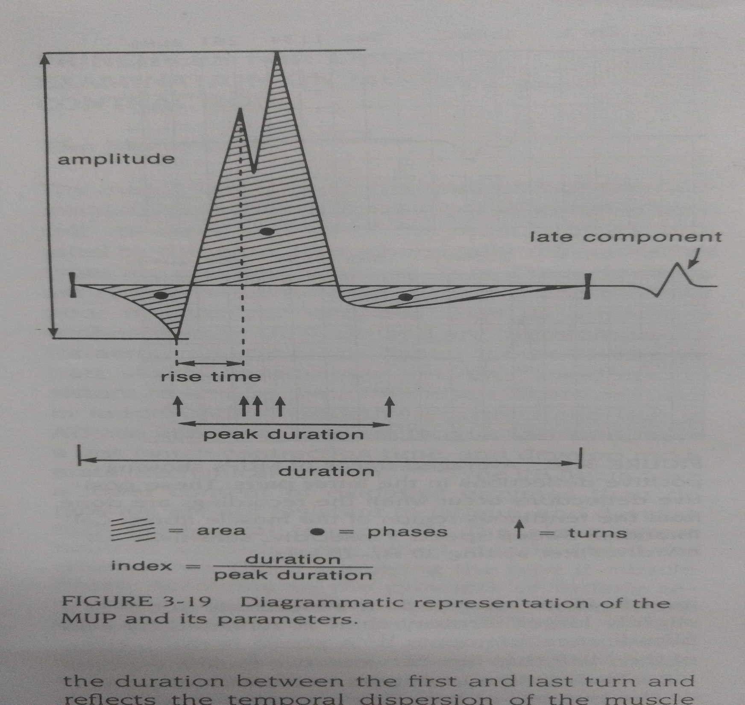

Slide 64
Stability
MUAP usually are stable in morphology from potential to potential.
This stability is due to the fact that each time a nerve action potential is generated there is normally effective transmission across the NMJ and all muscle fibers of the motor unit fire.
Unstable MUAP may result from impaired NMJ transmission, when individual muscle fibers either are blocked or come to action potential at varying intervals leading to a MUAP that changes in configuration from impulse to impulse.
There is a change between potentials in either the amplitude or the number of phases or both.

Slide 65
Discharge pattern of potential at maximal activity-
Mild voluntary contraction causes low, isolated frequency( one or two impulse per second ).
During muscle contraction there are only two ways to increase muscle force
-motor unit can increase their firing rate
-Additional motor unit can fire
One increases force using a combination of these two processes resulting in orderly recruitment of motor unit.

Slide 66
With smallest contraction a single motor unit normally begins firing semi rhythmically as one increases force the first motor unit increases the firing rate then second motor unit begins to fire and so forth additional motor units being recruited as force is increased
With greater contraction, many motor units begin to fire very rapidly.
Simultaneously, activation of different motor units no longer allows recognition of individual unit.
Hence, this summated response is usually referred as an interference pattern.

Slide 67
Analyzing the interference pattern is important to determine not only motor units discharged at maximal effort, but also number of firing motor units appropriate for extended muscle force.
Interference pattern depends upon
-Decreasing input to the motor neuron pool
-Anterior horn cell
-Peripheral nerves
-Root involvement
-Neuro muscular transmission
-Muscle fibres

Slide 68
Normally the ratio of firing frequency to the number of different MUAPs firing is approximately 5:1.
Thus, by the time first MUAP firing frequency reaches 10 Hz, a second MUAP should begin to fire; by 15Hz , the third unit should fire, and so forth.
During maximal contraction, multiple MUAPs normally overlap and create an interference pattern in which no single motor unit can be distinguished.
Interference pattern depends on two processes ; Activation and recruitment

Slide 69
Activation refers to the ability to increase firing rate.
This is central process.
Poor activation may be seen in diseases of CNS or as a manifestation of pain, poor cooperation or functional disorders, judged by submaximal sustained firing rate.
Recruitment refers to the ability to add motor units as the firing rate increases.
Decreased recruitment occurs when there has been loss of MUAPs usually through axonal loss or conduction block.
Recruitment is reduced primarily in neuropathic diseases, rarely in severe end stage myopathy if every muscle fiber of a MUAP is lost, the number of MUAPs also will effectively decrease, leading to reduced recruitment.

Slide 70
Early rectruitment
It is inappropriate firing of many motor units to generate a small amount of force.
Diseases in which there is dropout of individual muscle fibers from a motor unit(eg. Myopathies , NMJ diseases with block ) the motor unit becomes smaller and subsequently generates less force.
Because each motor unit generates less force, many motor units must fire to generate even a small amount of force.
On the monitor, many MUAPs will appear to fire almost simultaneously, with small amounts of force

Slide 71
Indications for EMG
Mononeuropathy
Mononeuropathy Multiplex
Radiculopathy
Plexopathy (Brachial or Lumbosacral)
Diffuse neuropathies
Myopathy
Muscular dystrophies
Anterior Horn Cell Disorders

Slide 72
Contraindication
Bleeding disorder
Recurrent systemic infection
Localised inflammation
Skin lesion
inflammation
Bleeding
Vasovagal episode

Slide 73
Abnormal Responses
Fibrillation potentials
Positive sharp waves
Complex repetitive discharges
Fasciculation potentials
Myokymia
Neuromyotonia
cramps

Slide 74
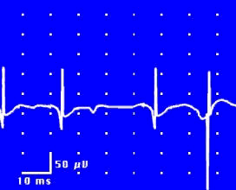
Fibrillation potential
Small amplitude and duration
Initially positive
Duration: 1-2 ms
Amplitude: 20-300μV
Occur at 0.5 to 15/sec
Sound like rain falling on roof top or wrinkling tissue paper
fibrillation potential.mp4

Slide 75
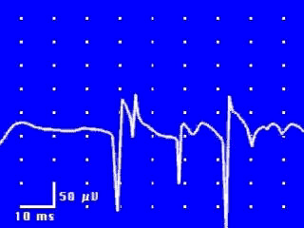
Positive sharp waves
Amplitude- 50-200μV with peak to peak amplitude reaching 1mV
Discharge frequency- 2 – 100/sec
Sounds like a dull thud
Indicative of LMN lesions
Usually accompanied by Fibrillation Potentials
Saw tooth appearance
positive sharp wave.mp4

Slide 76
Complex repetitive discharges
Freq – 5-100 impulses/sec
Amplitude - 50μV to 1 mV
Duration – upto 100ms
Sound- diver bomber
Occur in myotonia, polymyositis, neurogenic atrophy
crd.mp4

Slide 77
Fasciculation potentials EMG- Fasciculations (video 2).mp4
May be bi, tri or polyphasic
Duration – 7-20msec
Amplitude - 50μV to 30mV
Occur randomly
irregularly at variable rates between 1 and 500 /min
Sounds like low pitched thump
Due to irritation or degeneration of AHC, nerve root compression, muscle spasm or cramps

Slide 78
Myokymia
Spontaneous muscle potentials associated with fine worm like quivering
Fire in a fixed pattern and rhythm
Bursts- 2-10 potentials firing at 40-60Hz
Bursts recur at regular intervals of 0.1 to 10 sec

Slide 79
Neuromyotonia
Continuous motor unit potentials firing at a rate of 100-300 Hz which continue for long run or recur in bursts
Found in syndromes of continuous muscle fiber activity, anticholineesterase poisoning, tetany, spinal muscular atrophy
Occur in peripheral nerve irritation during surgery and serve as valuable guide to possible nerve damage

Slide 80
Cramps
Spontaneous discharges of potentials occurring at 40-60 Hz, usually with an abrupt onset and cessation
Occur in salt depletion, chronic myogenic atrophy, myxoedema, pregnancy, uremia and also in normal individuals

Slide 81
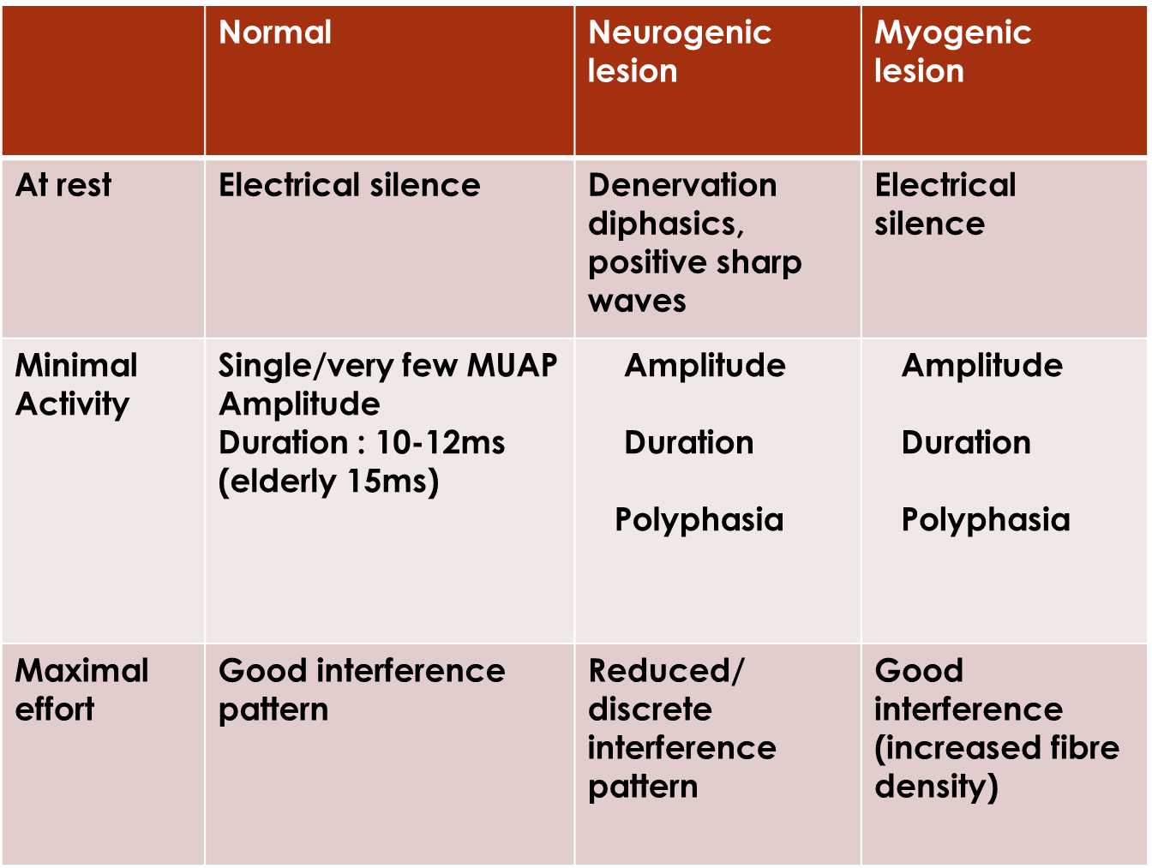

Slide 82
References
Books
Jagmohan singh
Susan o sullivan
Umphred darsi
The ABC of EMG
Mitra
Cameron
The fundamentals of Electromyography by Roger Graham Whittaker
History of electromyography and nerve conduction studies: A tribute to the founding fathers by Mohamed Kazamel et al, 2017

